Slide 1
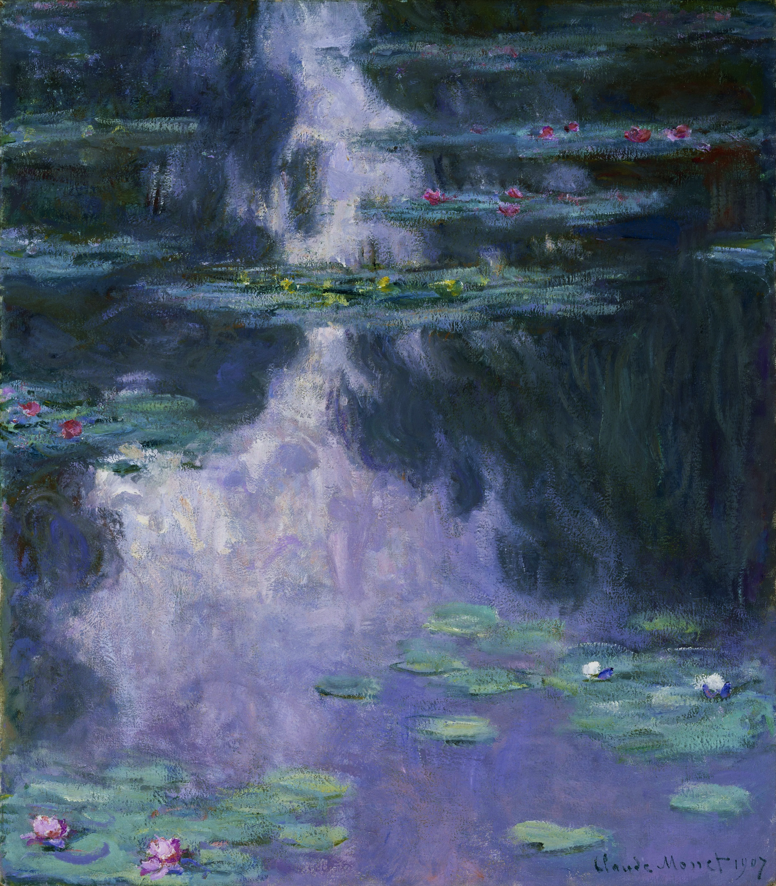


Dreamtide
AKDONG
21st Regular Concert
Outset Island (The Legend of Zelda OST)
Windfall Island (The Legend of Zelda OST)
Reprise (센과 치히로의 행방불명 中)
Ponyo on the Cliff by the Sea (벼랑 위의 포뇨 中)
Pavane pour une indante défunte
A Midsummer Night’s Dream: Overture
The Nutcracker: Grand Pas de Deux
The Nutcracker: Dance of the Sugar Plum Fairy
Hungarian Dance No.1 in G Minor
Kenta Nagata
Kenta Nagata
Joe Hisaishi
Joe Hisaishi
M. Ravel
F. Mendelssohn
P. I. Tchaikovsky
P. I. Tchaikovsky
J. Brahms
2025.05.23. (FRI) 7:30 PM
CT Art Hall (S2)

Slide 2
Dreamtide
AKDONG
21th Regular Concert
Windfall Island (The Legend of Zelda OST)
Outset Island (The Legend of Zelda OST)
Reprise (센과 치히로의 행방불명 中)
Ponyo on the Cliff by the Sea (벼랑 위의 포뇨 中)
Pavane pour une indante défunte
A Midsummer Night’s Dream: Overture
The Nutcracker: Grand Pas de Deux
The Nutcracker: Dance of the Sugar Plum Fairy
Hungarian Dance No.1 in G Minor
Kenta Nagata
Kenta Nagata
Joe Hisaishi
Joe Hisaishi
M. Ravel
F. Mendelssohn
P. I. Tchaikovsky
P. I. Tchaikovsky
J. Brahms
2025.05.23. (FRI) 7:30 PM
CT Art Hall (S2)

